Slide 1
Week 9
March 12 2021

Slide 2
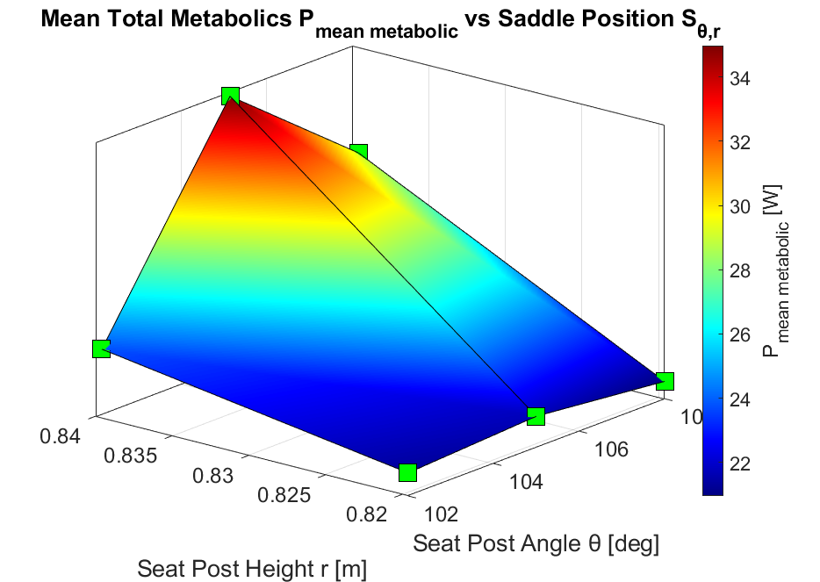
CMC Plot

Slide 3
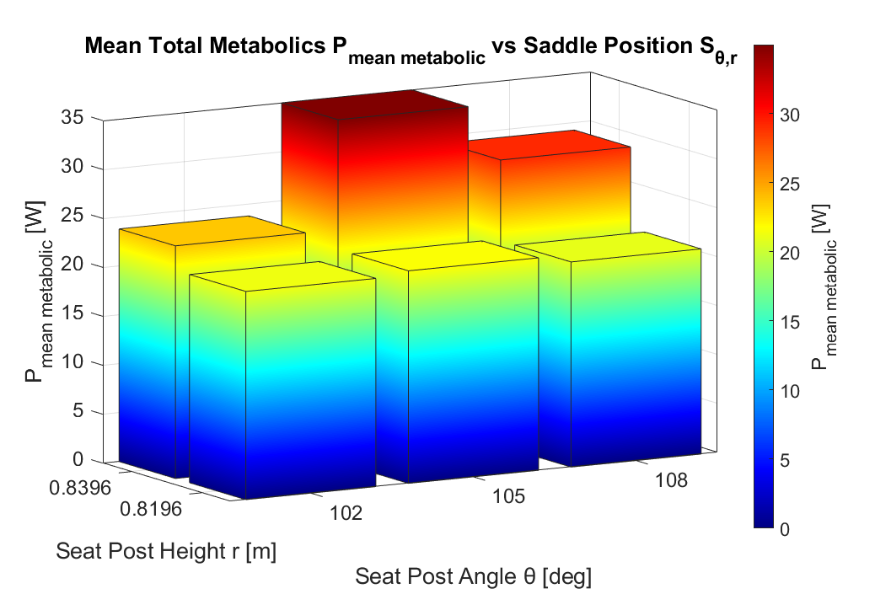
CMC Plot (2nd visualization)

Slide 4
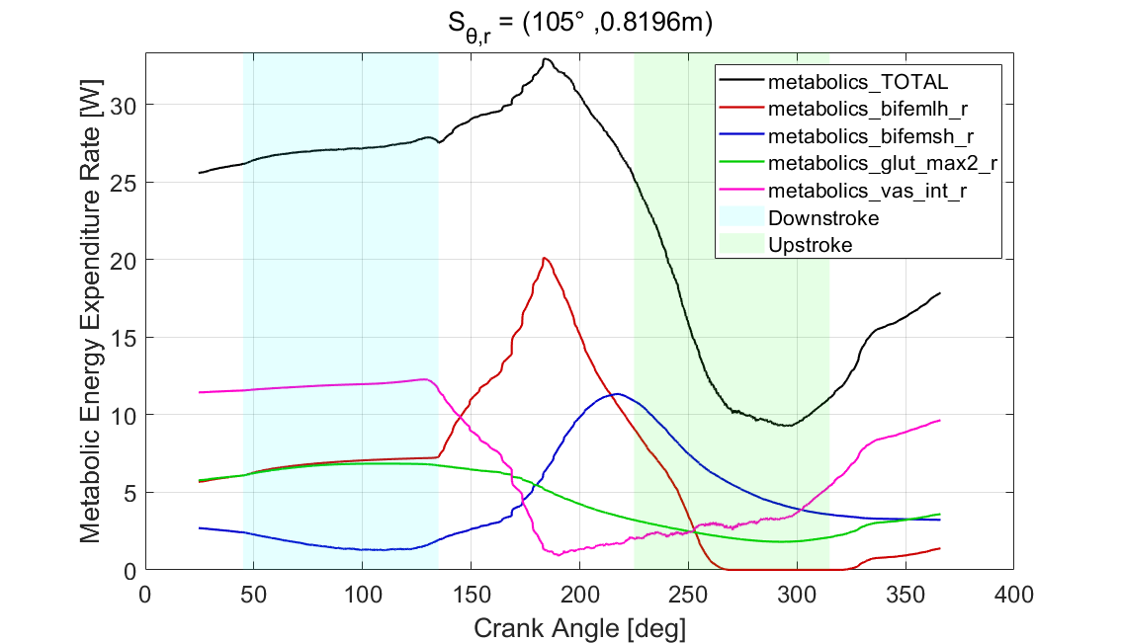
Metabolics by Saddle Position

Slide 5
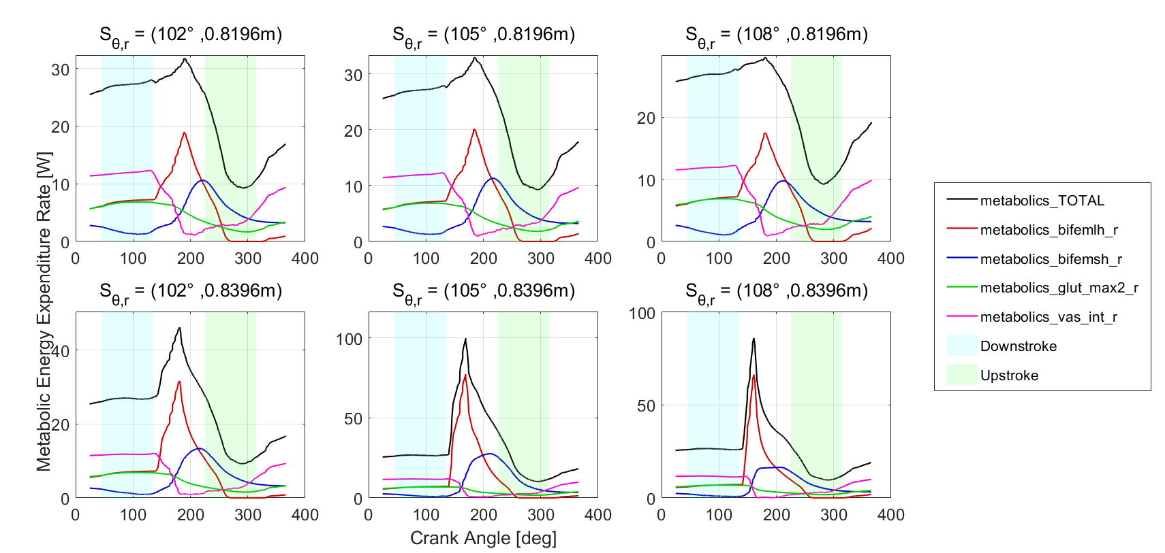
Metabolics by Saddle Position

Slide 6
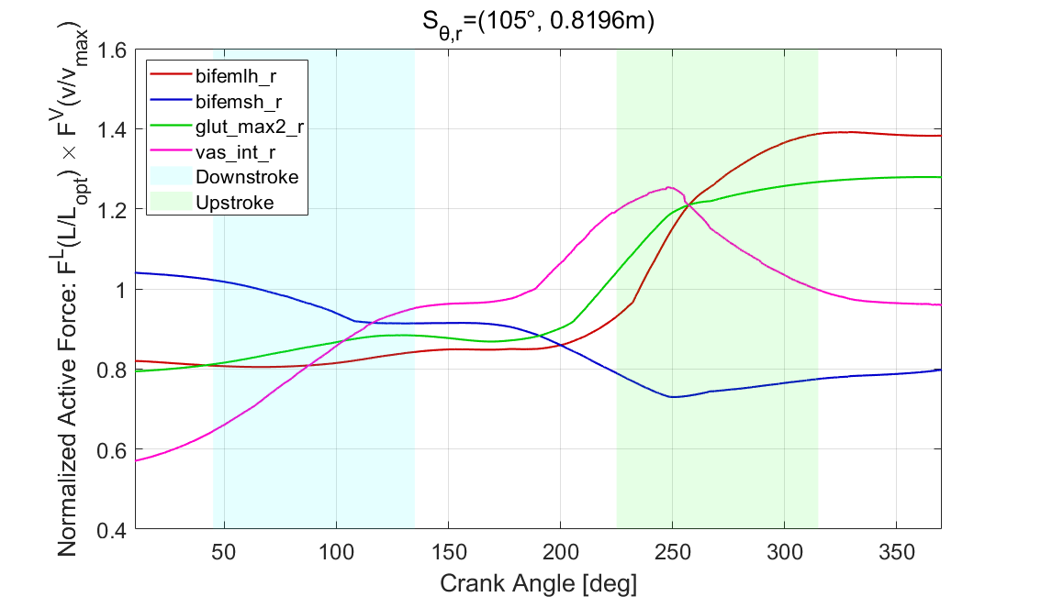
Max Active Force Plots by Saddle Position

Slide 7
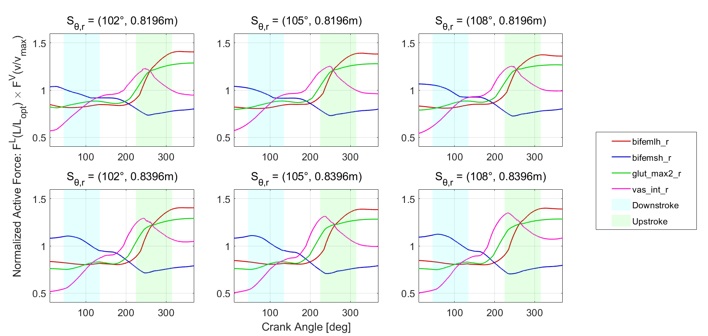
Max Active Force Plots by Saddle Position

Slide 8

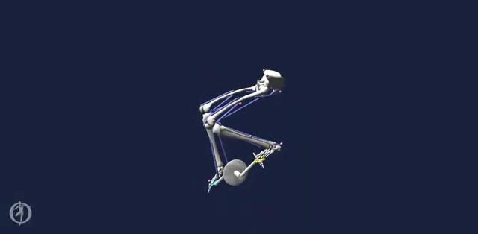
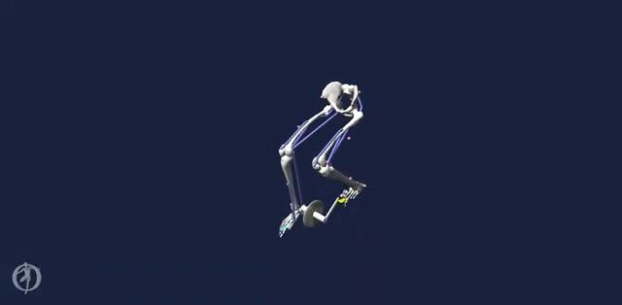
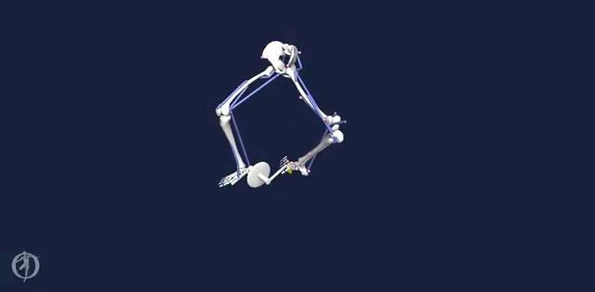
2-Leg Model Bloopers

Slide 9
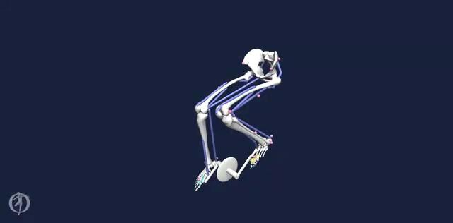
2-Leg Model

